Slide 1
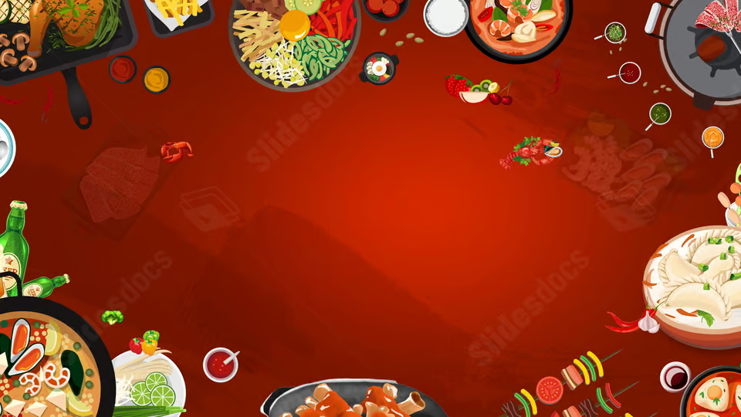




ZOMATO ANALYSIS by Group 1
Tools Used

Slide 2
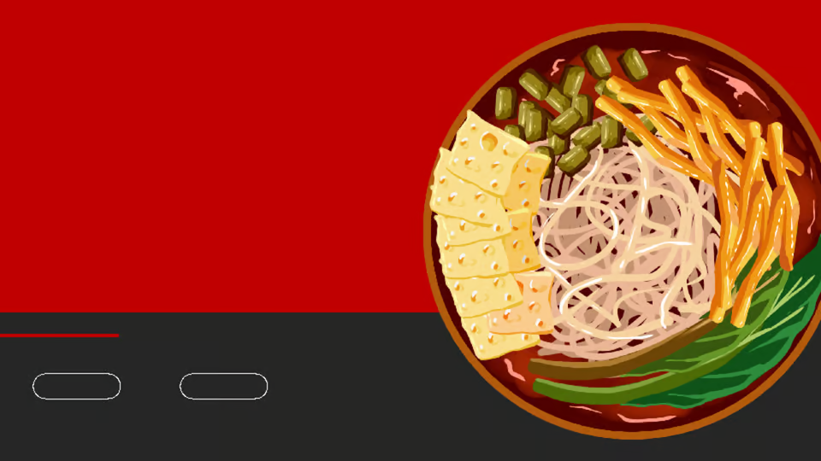
About Zomato
Launched in 2010, Zomato technology platform connects customers, restaurant partners and delivery partners, serving their multiple needs.
Customers use Zomato platform to search and discover restaurants, read and write customer generated reviews and upload photos, order food delivery, book a table and make payments while dining-out at restaurants.
On the other hand, Zomato also provides restaurant partners with industry-specific marketing tools which enable them to engage and acquire customers to grow their business while also providing a reliable and efficient last mile delivery service.

Slide 3

About Dataset
The dataset is derived from Zomato's public repository or relevant sources and contains information about restaurants, their ratings, cuisines, cost, etc.
There are total 9551 rows with 31 attribute all together.
Attributes Includes: Restaurant Name, Location/City, Cuisine Type, Average Cost for Two, Ratings, Date range, Indian Rs cost, $ cost, etc.
This dataset contains data from year 2010 to 2018.
The dataset was analyzed to uncover trends in customer preferences, restaurant performance, and delivery efficiency, and to provide actionable insights for Zomato's operations.

Slide 4
Challenges faced
1. Difficulty: Identifying the most relevant KPIs to add in the project and align them with the business goals was a challenge.
Solution: I collaborated with my team to ensure that the KPIs were not only meaningful but also actionable. We focused on KPIs that directly impacted key business areas like customer satisfaction and order performance.
2. Difficulty: Data Quality and Integration
Solution: we used data cleaning techniques in Excel and SQL to identify and correct inconsistencies. I also worked with my team to ensure proper data integration and consistency across different systems.
3. Difficulty: Dashboard Design : Designing dashboards that were both informative and easy to understand, while balancing the need for interactivity and simplicity, was a struggle.
Solution: we focused on the end-user experience by keeping the dashboard simple and intuitive. we used logical groupings, clear visual cues, and interactivity like filters to make the data accessible without overwhelming the user.

Slide 5
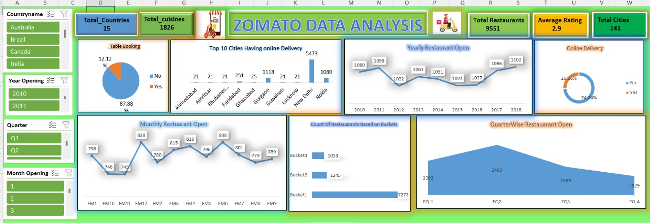
Excel Dashboard

Slide 6
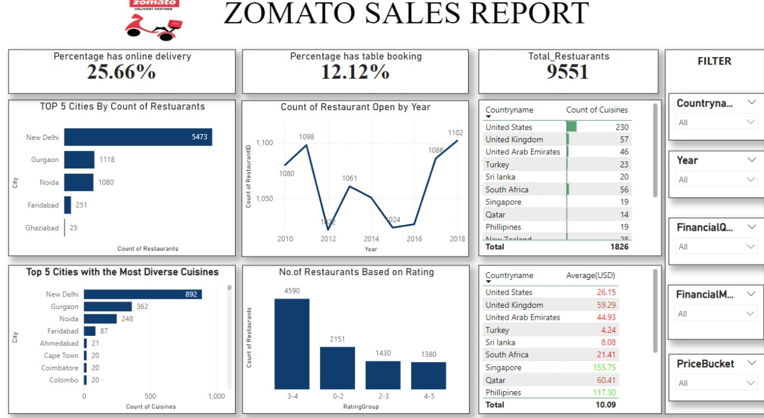
Power BI Dashboard

Slide 7
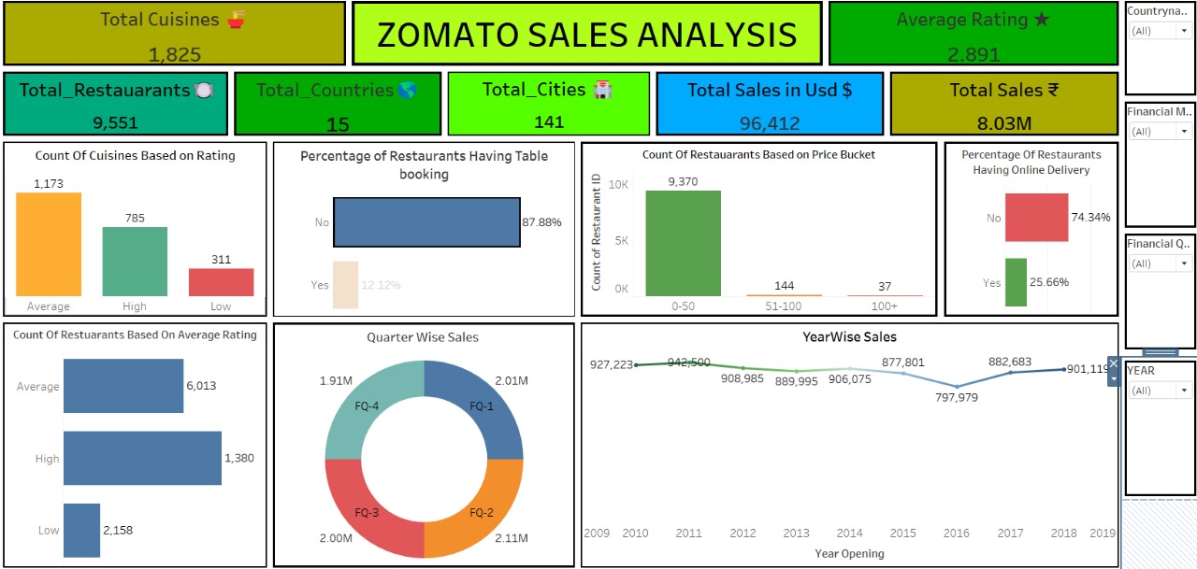
Tableau Dashboard

Slide 8
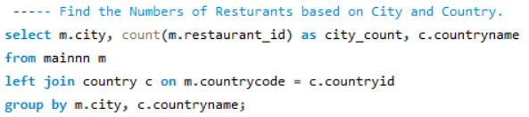
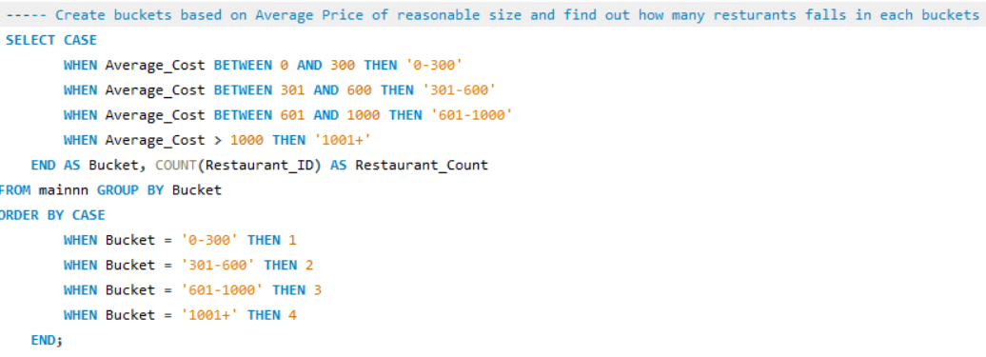
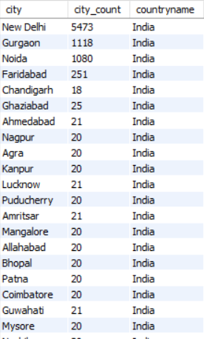
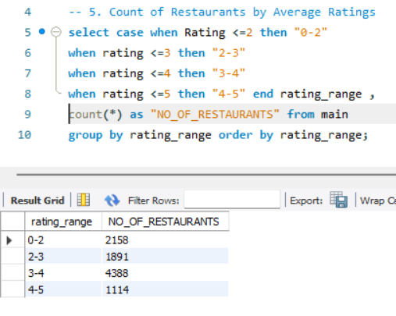
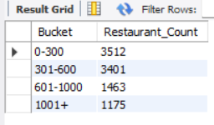
SQL Queries

Slide 9
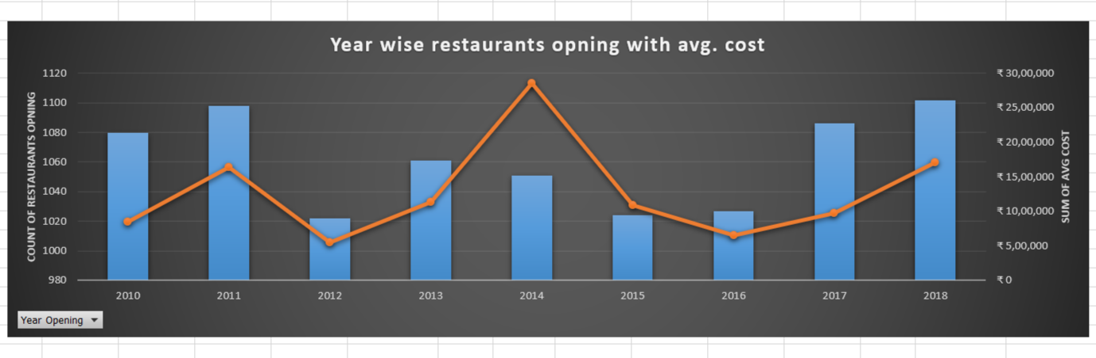
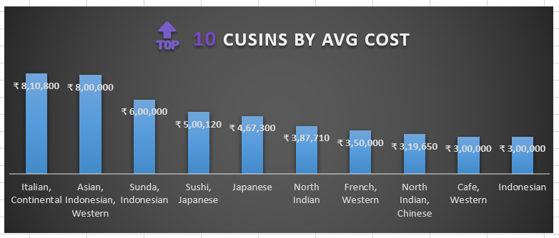
Some Insights

Slide 10
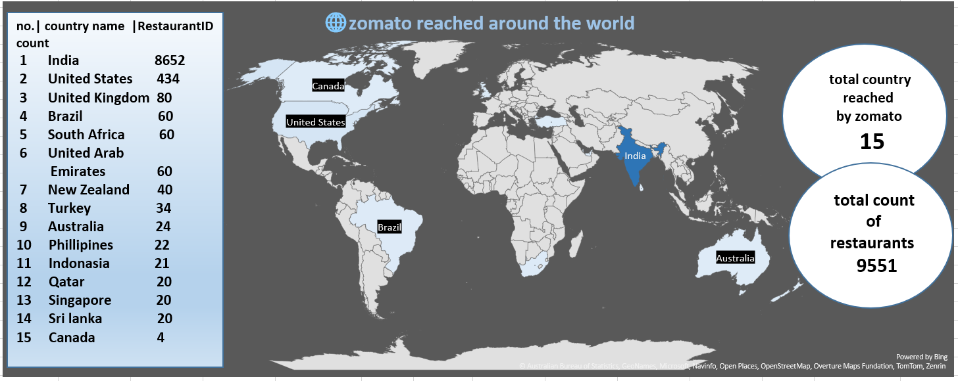

Slide 11
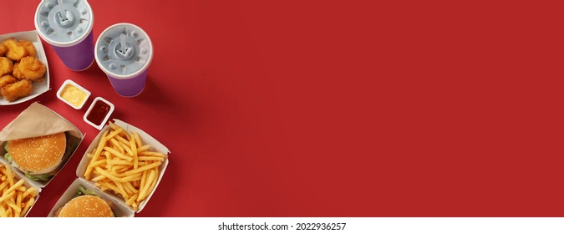
Key points
There were total 9551 restaurants out of which only 25.66% has Online delivery service and 12.12 % has table booking service.
Out of total 9551 restaurants, 8652 restaurants are in India alone and the remaining ones are spread all over the world.
Popular cuisines like Indian and Chinese dominate customer preferences.

Slide 12
Importance of Forecasting in Data Analysis
Strategic Decision-Making
Helps make informed choices about growth and market strategies.
Resource Allocation
Optimizes inventory, staffing, and production to reduce costs.
Risk Mitigation
Identifies potential risks and helps prepare for uncertainties.
Competitive Advantage
Allows businesses to stay ahead by spotting trends and opportunities.
Financial Planning & Growth
Supports budgeting, cash flow management, and sustainable growth.

Slide 13
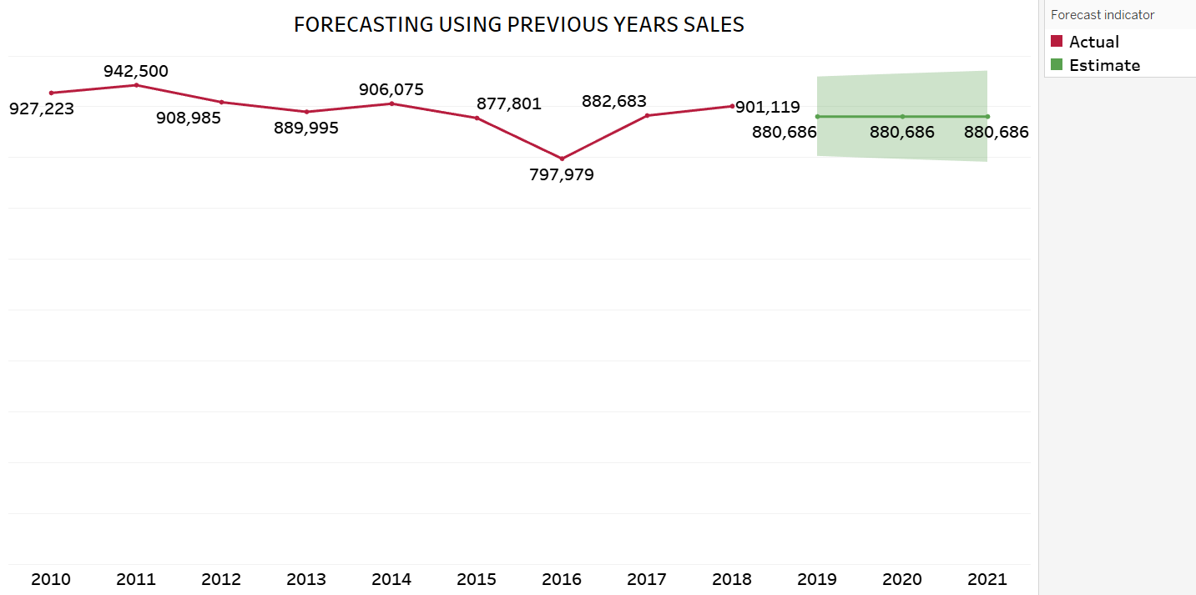
FORECASTING SALES USING PAST DATA

Slide 14
Top 5 Reasons for Zomato Sales Downfall
Increased Competition The rise of other food delivery platforms (e.g., Swiggy, Uber Eats) erodes market share and customer loyalty.
Market Saturation Zomato may have reached a point of limited growth in existing markets, especially in urban areas.
Economic Downturn Reduced consumer spending during economic slowdowns or crises leads to lower demand for non-essential services like food delivery.
Service Quality Issues Poor delivery times, food quality, or customer support can drive customers away, hurting brand reputation.
Changes in Consumer Behavior Shifting preferences, such as a move towards home cooking or healthier eating, can reduce demand for delivery services.

Slide 15
Top 5 Ways to Boost Zomato's Sales
Expand into New Markets Target Tier 2/3 cities and international regions to capture new customers.
Diversify Offerings Introduce subscription services (e.g., Zomato Pro) and launch cloud kitchens for more variety and convenience.
Enhance Customer Experience Personalize the user experience with recommendations, and ensure faster, reliable deliveries for greater satisfaction.
Increase Marketing & Promotions Invest in targeted digital ads, referral programs, and seasonal promotions to attract and retain customers.
Leverage Strategic Partnerships Partner with popular restaurants, corporates, and food brands to increase visibility and drive bulk orders.

Slide 16

Conclusion:
The analysis of this Zomato dataset provided key insights into customer preferences, popular cuisines, cost dynamics, and operational efficiencies.

Slide 17
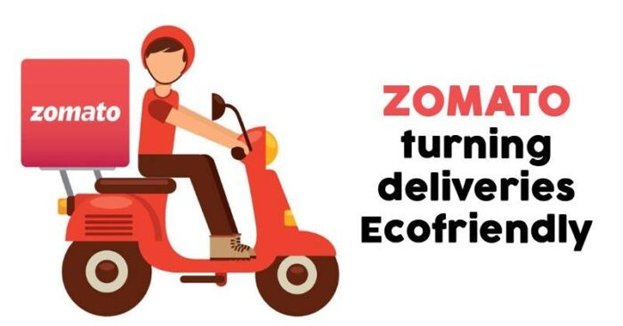
THANK YOU

